Slide 1

Breaking Security: Power Analysis & Fault Injection Attacks
A far-too-fast overview.
Dr. Colin O’Flynn
C.T.O. Assistant Professor
NewAE Technology Inc. Dalhousie University

Slide 2
About Me
Assistant Professor
Dalhousie University
Halifax, NS, Canada
Things I’ve done/do:
ChipWhisperer Project.
Philips Hue Worm attack.
Smart lock attack.
802.15.4 attacks.
Circuit Cellar columnist.
C.T.O.
NewAE Technology Inc.
Halifax, NS, Canada

Slide 3
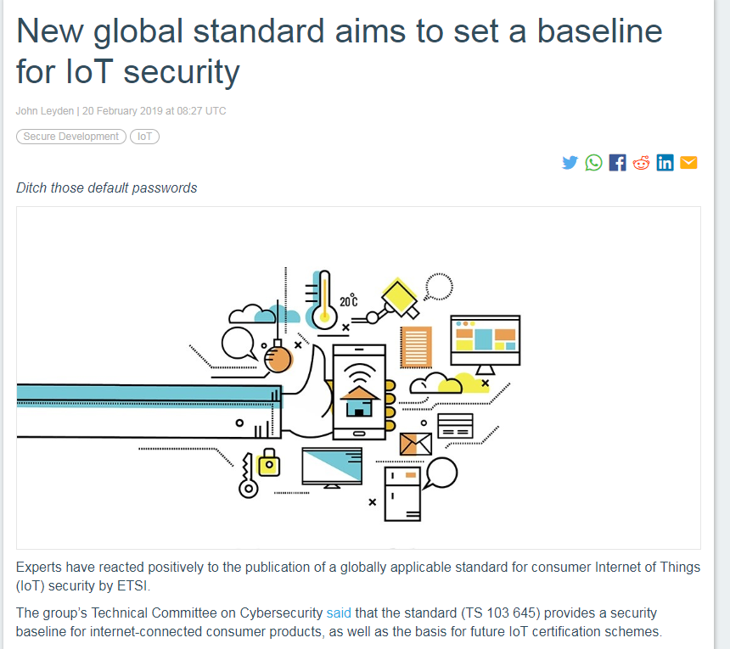
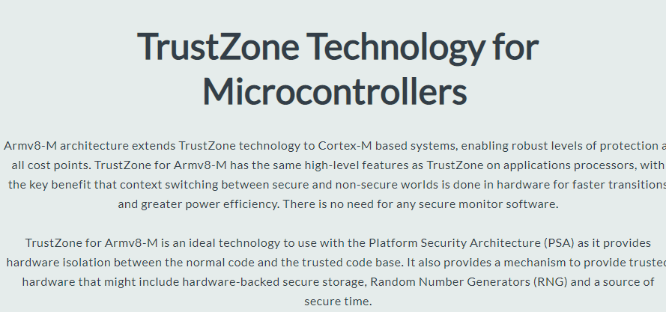
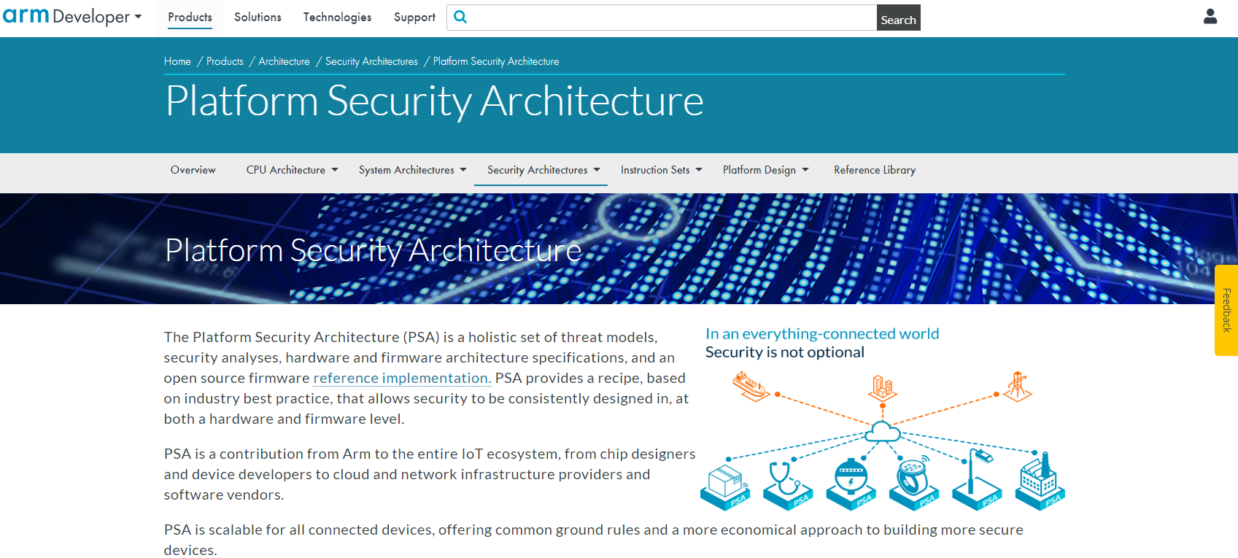
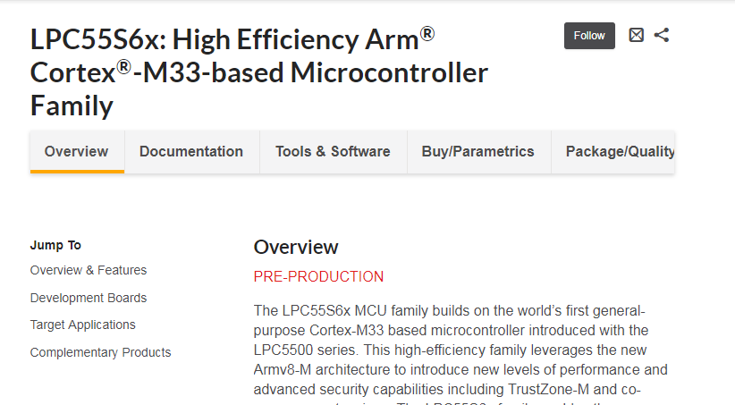
Embedded Security: We’ve Got Solutions!

Slide 4
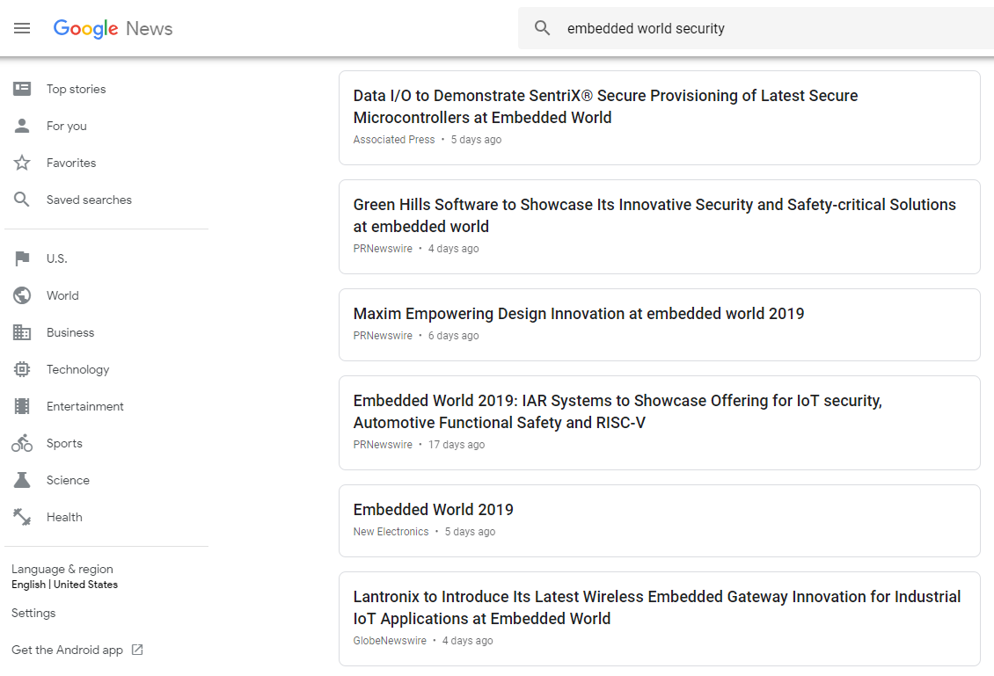

Slide 5
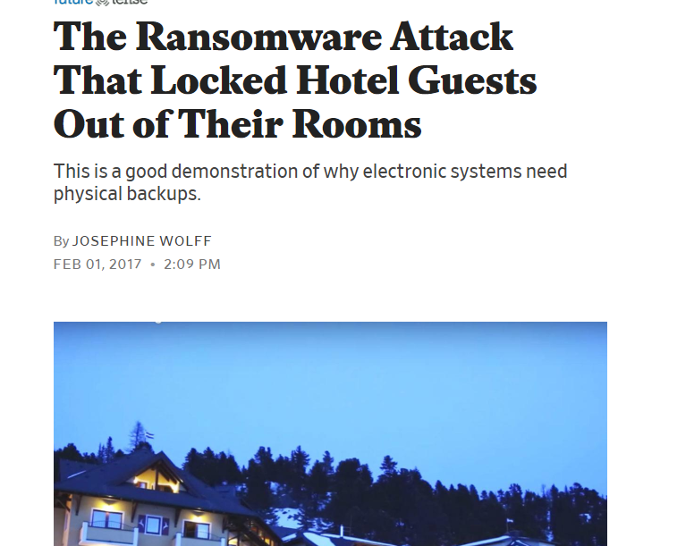

Slide 6
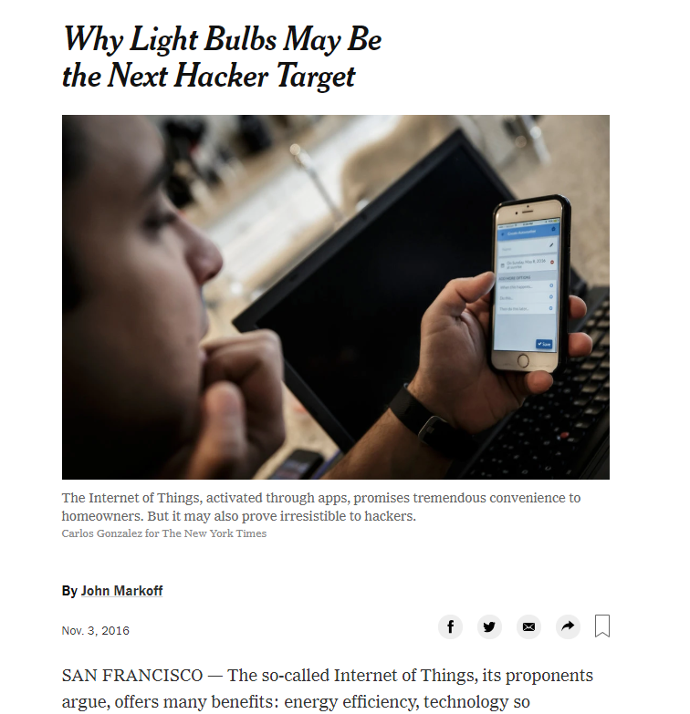

Slide 7
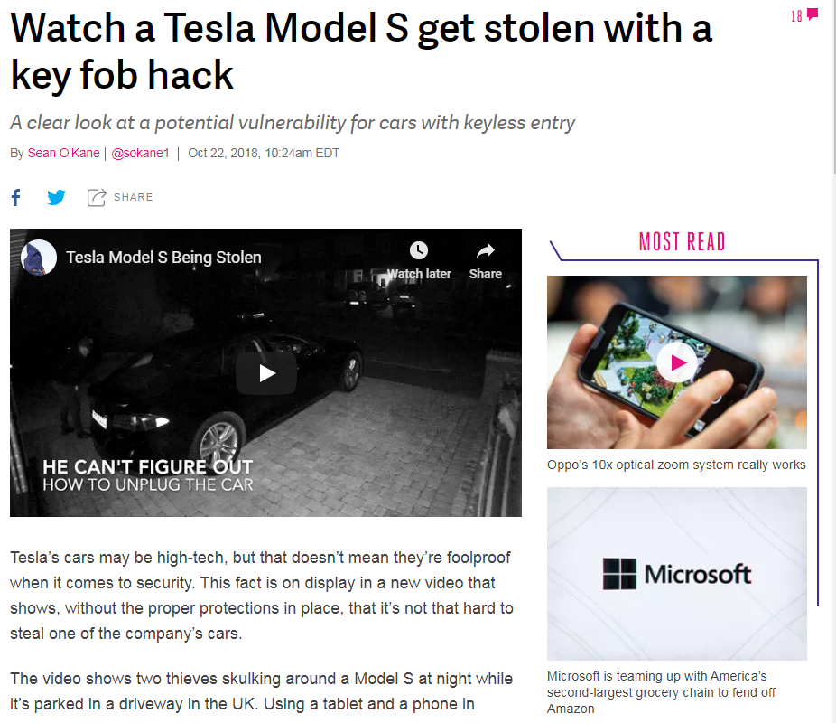

Slide 8
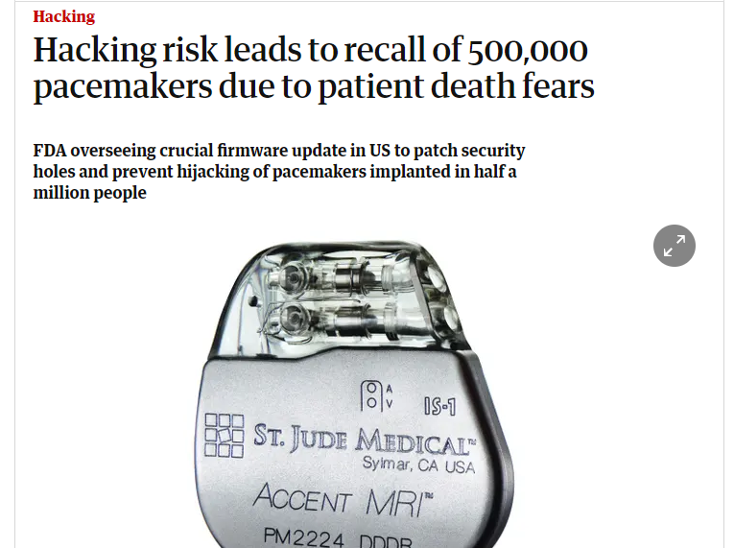

Slide 9
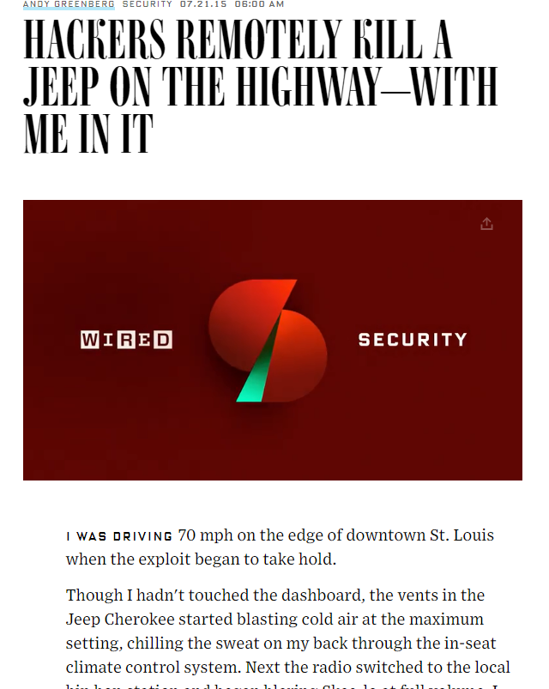

Slide 10

What went wrong??
Were solutions just not deployed (old devices)?
Were solutions misapplied?
Do solutions work?

Slide 11
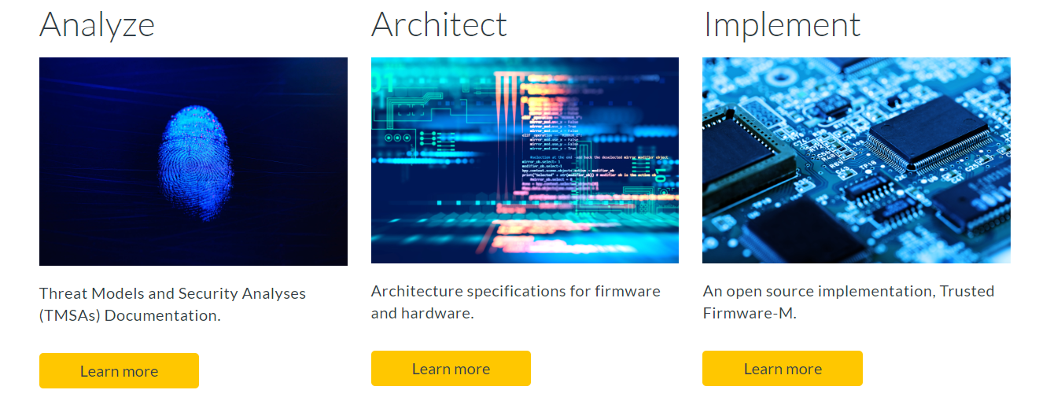
Example Solution: Platform Security Architecture

Slide 12
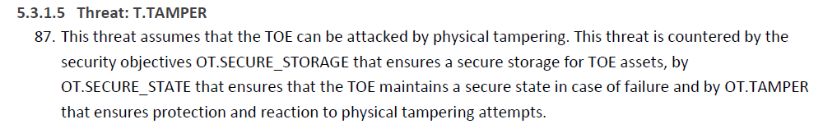
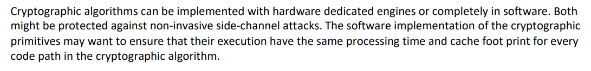
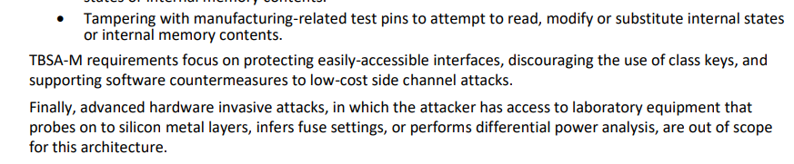
Threat Model
Security Model
Trusted Base System Architecture

Slide 13
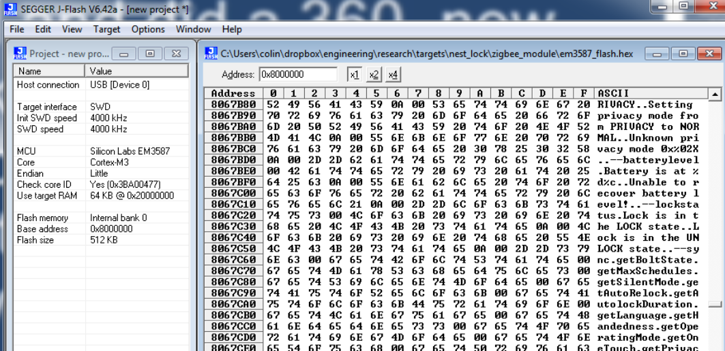
Reality: Consumer IoT Device (Released 2018)

Slide 14
Why care about “advanced” attacks?
Closing debug interface, using encryption, etc. is “easy” first step.
Attackers will quickly move to these advanced attacks, you may be unhappy to discover how well they work…
They aren’t that difficult in real life.
  I’m going to (try) and do some live for you right now.
  If you’d like to see more, I can show you some either at booth 4A-313, or in my workshop tomorrow!

Slide 15
Power Analysis & Fault Injection
These attacks are often much easier to execute than you expect.
Protecting against the attack is often very difficult/expensive.
Protecting against the effect is often easy *if* you know about the attack being possible.

Slide 16
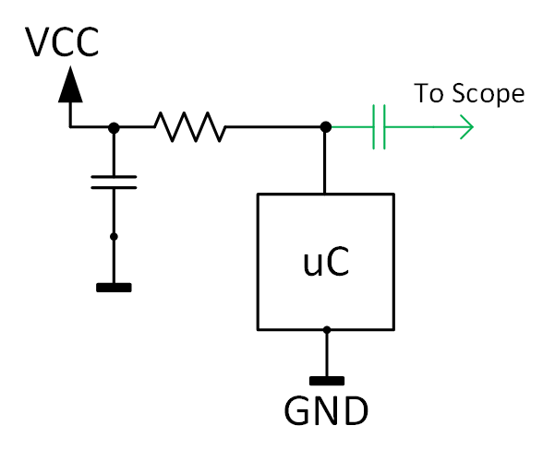
Part 1 – Side Channel Analysis

Slide 17
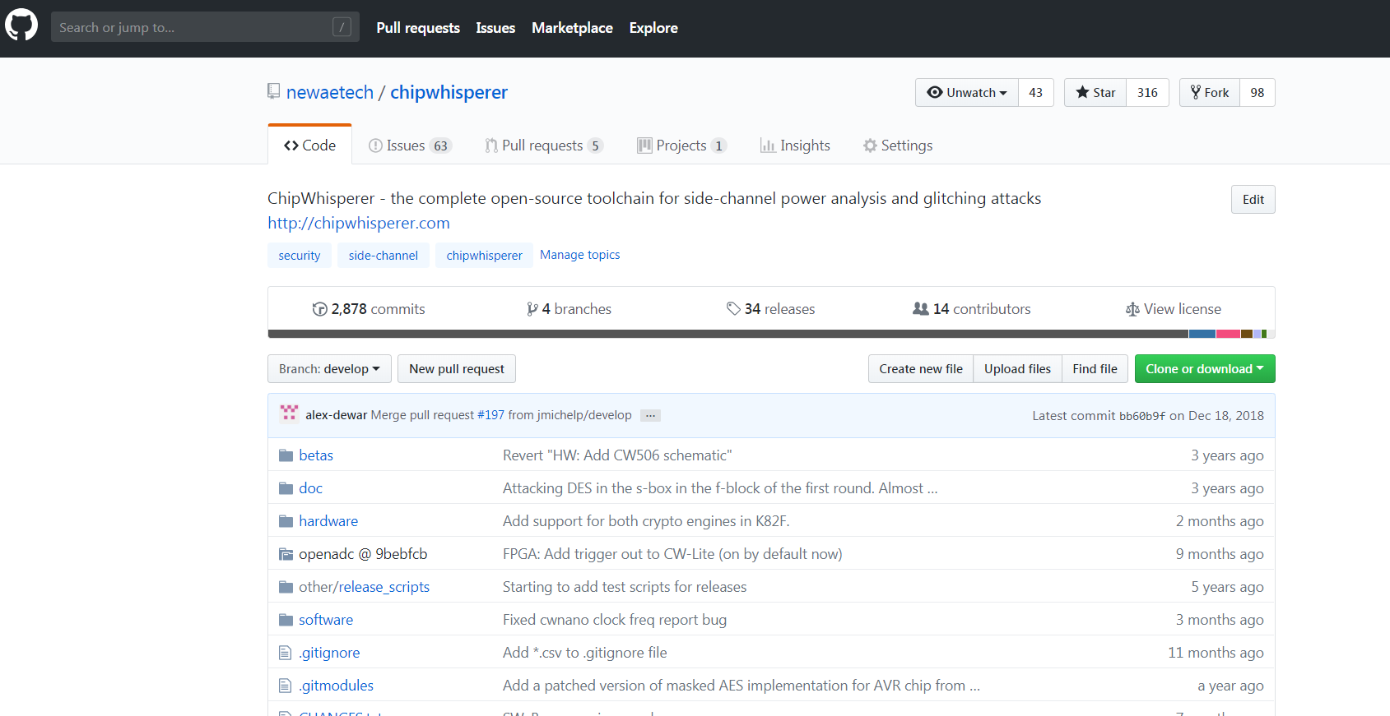
ChipWhisperer Project – Open Source!

Slide 18
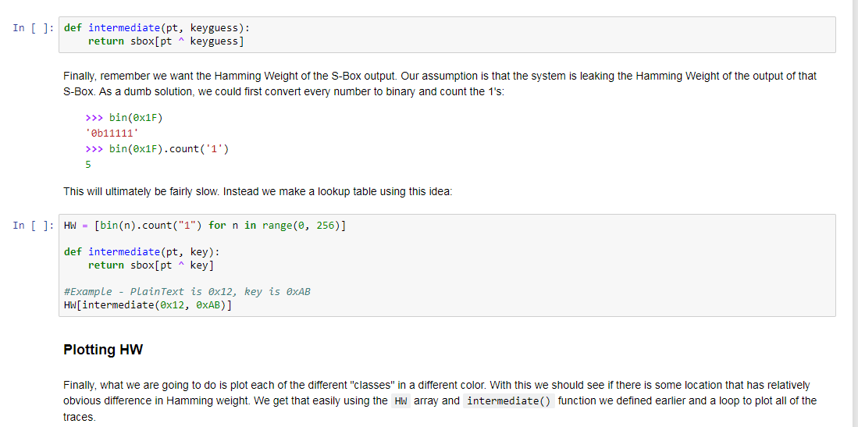
ChipWhisperer Project – Open Source!

Slide 19
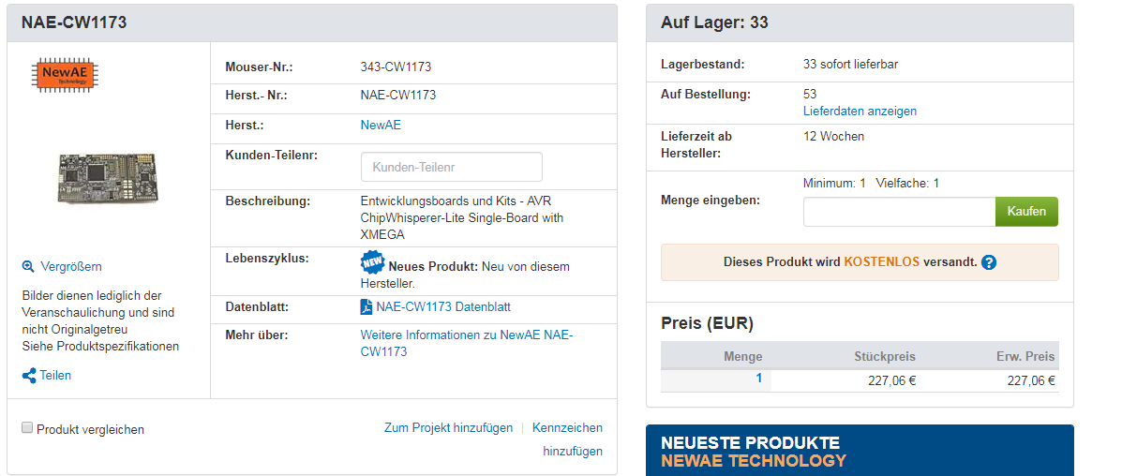
Side-Channel – Expensive, Lab Required, etc.

Slide 20
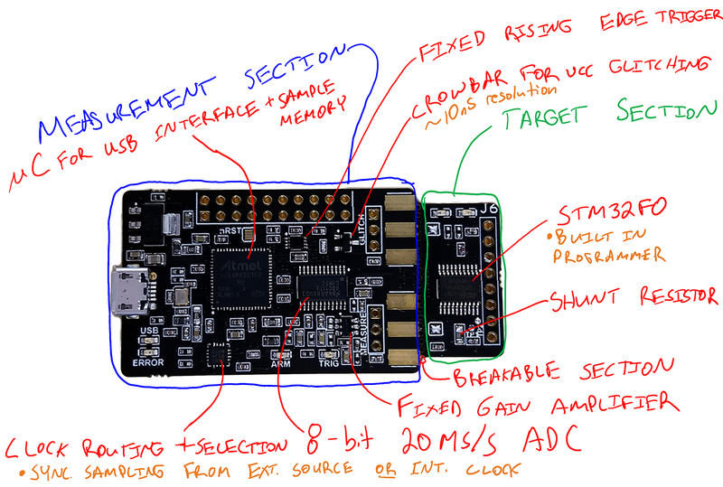
Side-Channel – Even Cheaper??
$50
Or in pint-equivalents:
Country | Avg. Pints
Germany | 20
Norway | 7
France | 8
Finland | 10
Sweden | 8
Italy | 11
England | 14
Ukraine | 86
https://budgettraveller.org/cheapest-beer-in-europe-check-my-europe-cheap-beer-index/

Slide 21
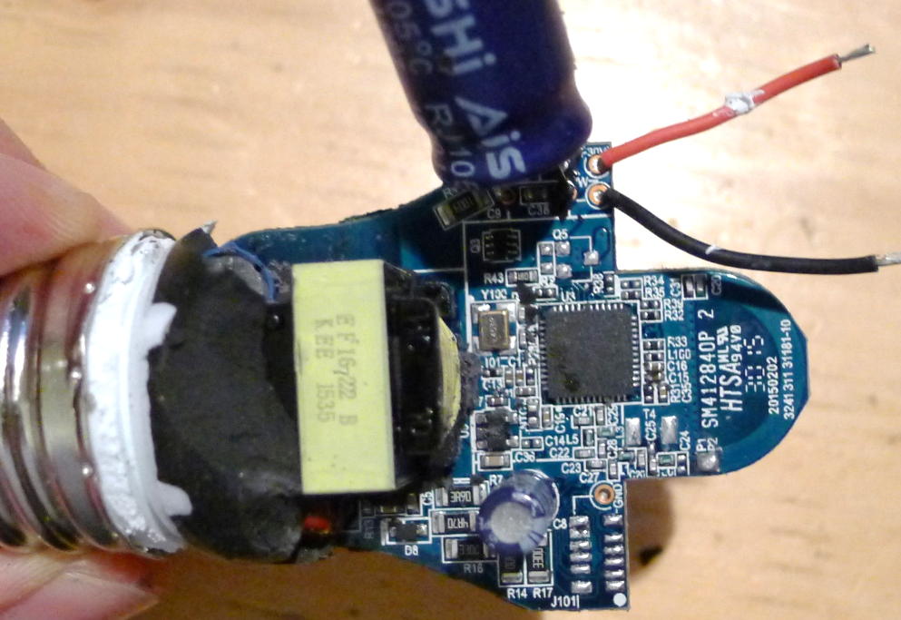
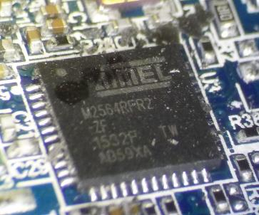

Slide 22
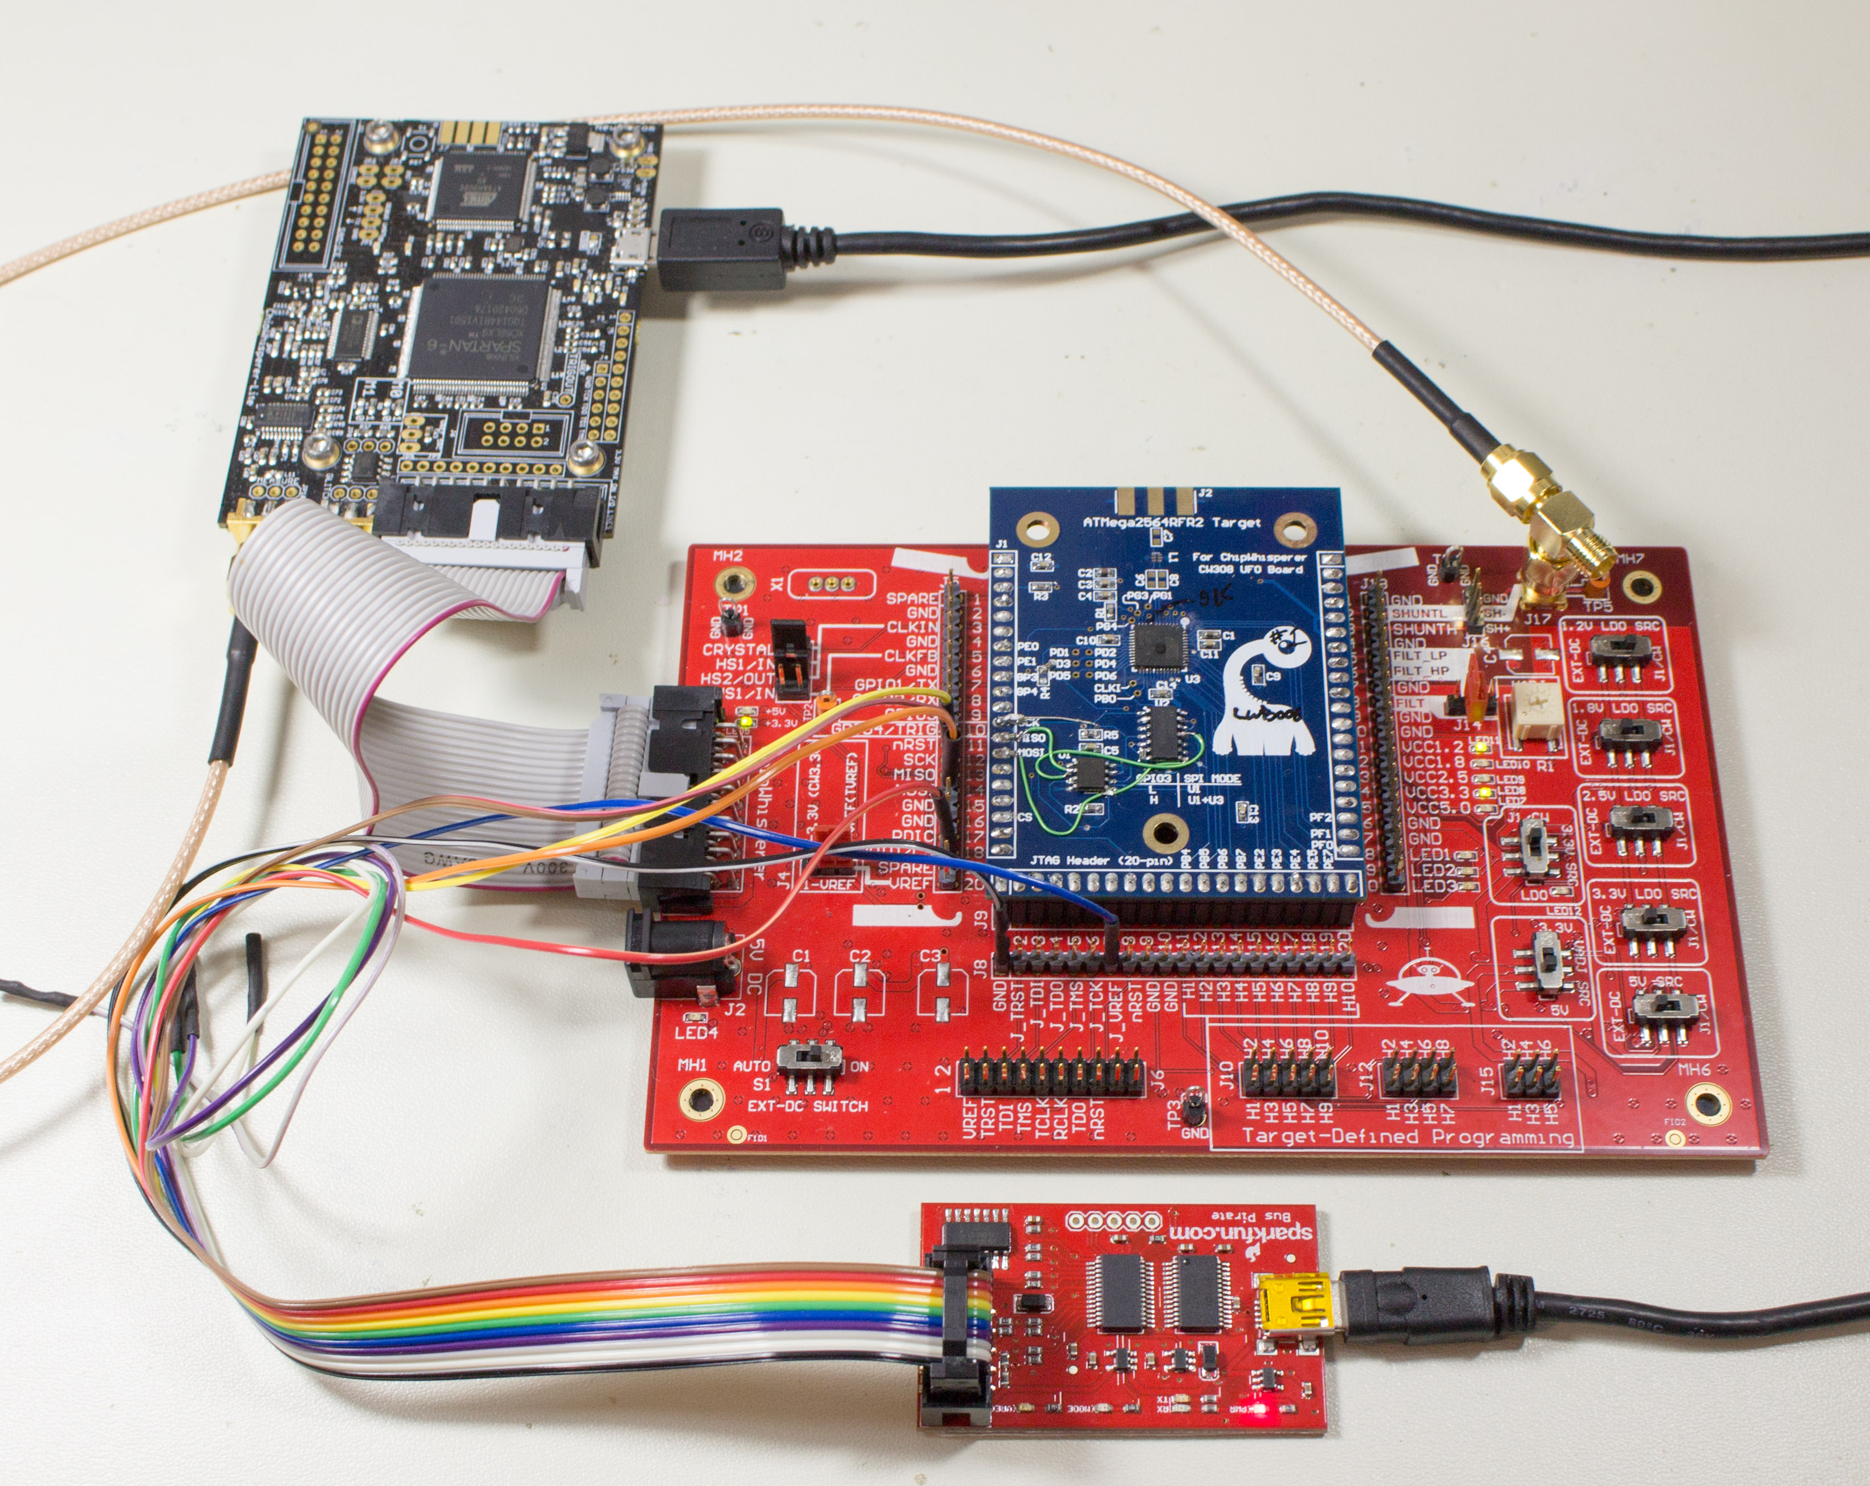

Slide 23
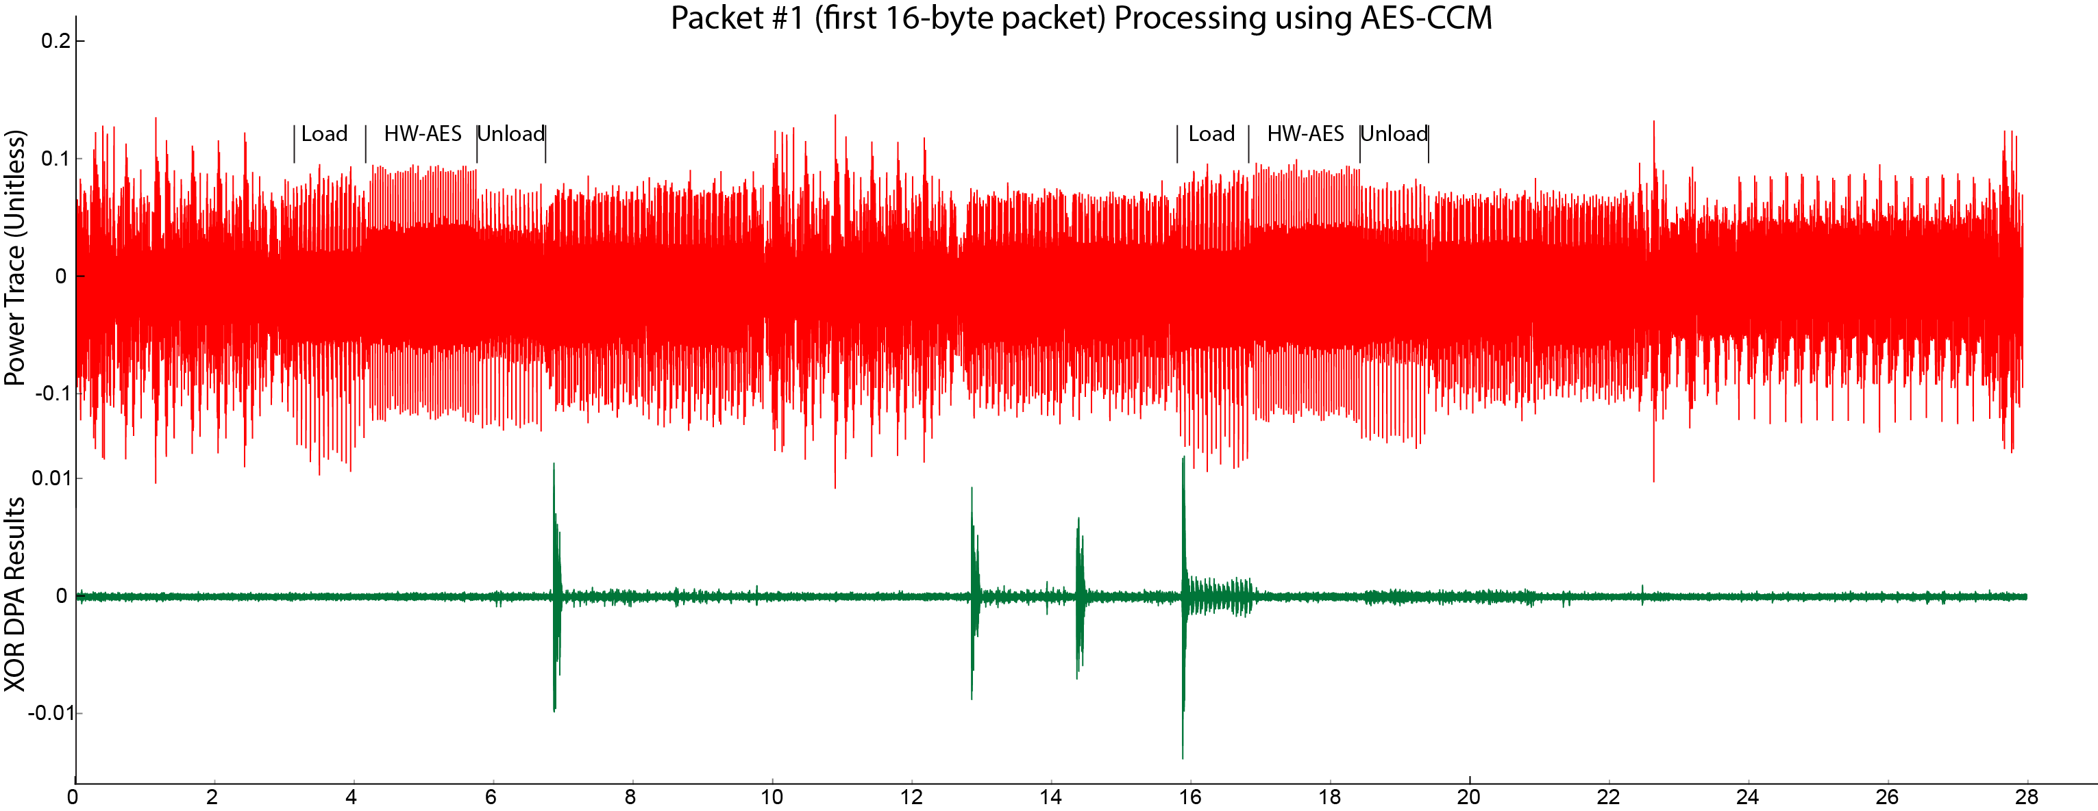

Slide 24
Would PSA TBSA have helped?
Trusted Base System Architecture
Shared keys were underlying problem in Philips Hue Attack.
Side-channel one method of recovering keys → without shared keys ‘worm’ wouldn’t be possible.

Slide 25
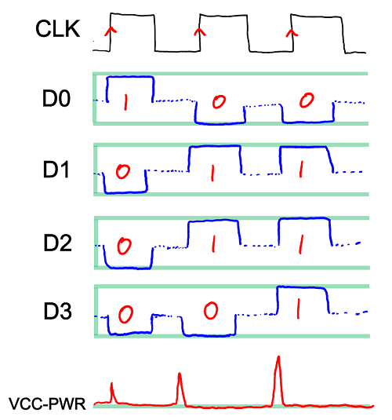
Power Analysis Theory

Slide 26
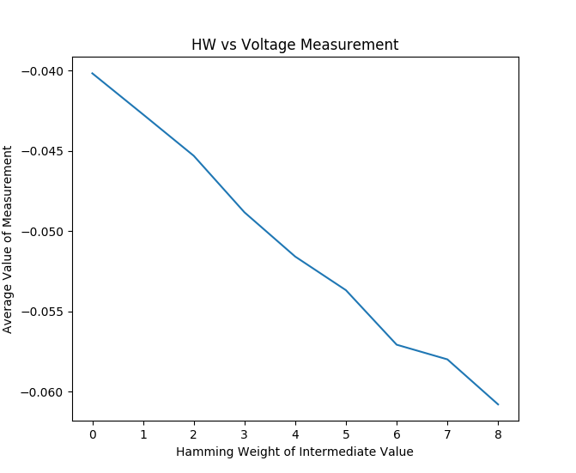

Slide 27
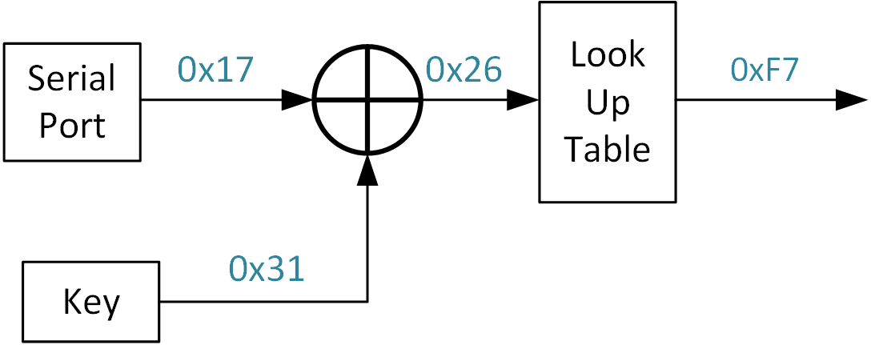
Applying to AES
Repeated 16x for AES

Slide 28
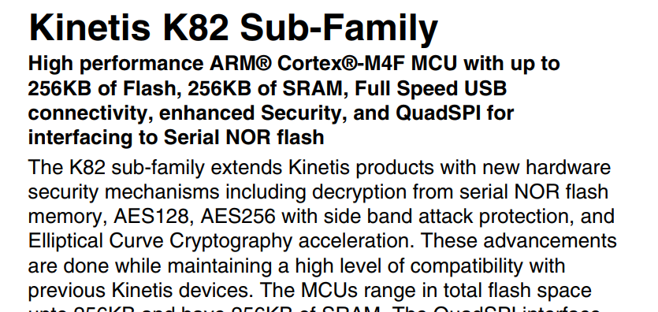
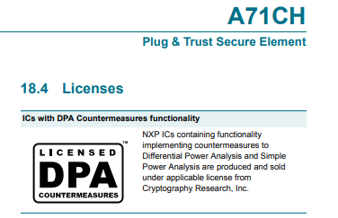
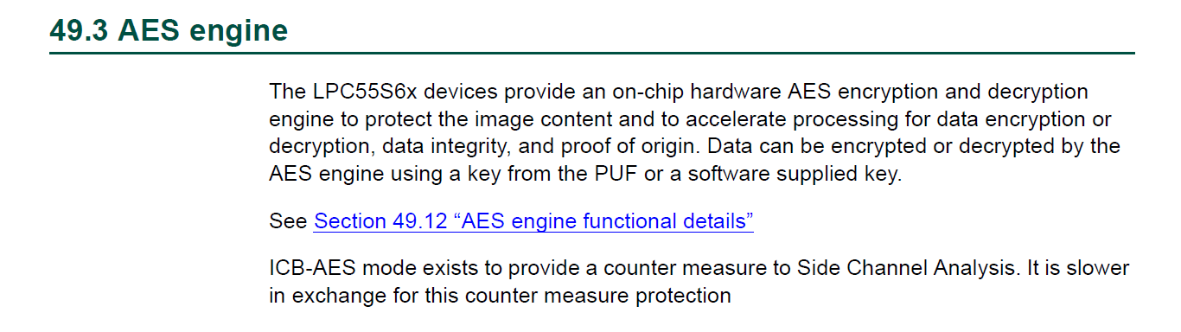
Selecting Secure Devices?

Slide 29
Still Problems
Devices with countermeasures but without Common Criteria (CC) rating may have unknown level of security.
As of yet no common “datasheet number” to help you (user) understand this.
May require you to perform your own testing → Part of why I started open-source ChipWhisperer project.

Slide 30
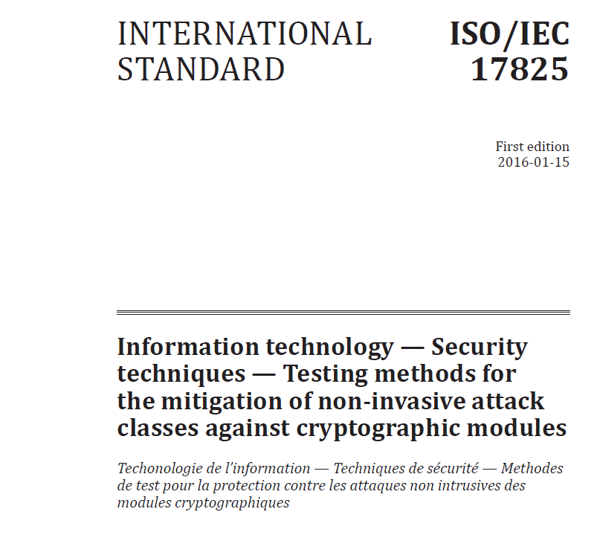
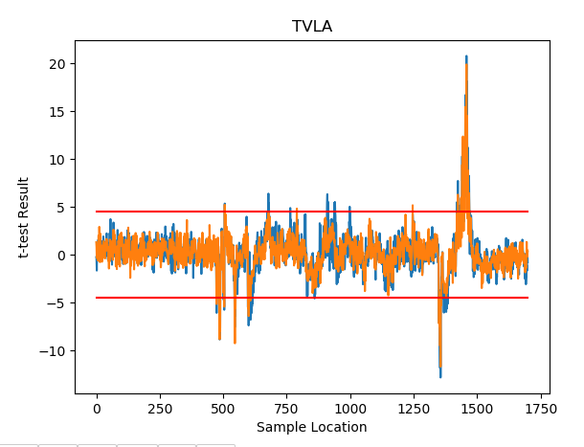
We might yet have hope…
Work on standardized testing methods (think – datasheet specs for security?).
Customers need to ask vendors for this type of data! With enough requests we might see it happen…

Slide 31
Enough Chat – Let’s Attack!
<Live Demo Hopefully>

Slide 32
How to protect against this?
Preventing DPA is hard. Most smart ideas get broken.
  Fundamentally the “signal” is present no matter what you do.
    Adding noise does (basically) nothing.
    Changing clock frequency is relatively easy to counteract.
    Algorithmic fixes (masking, etc) start to have real effect.
  Hardware changes improve this but cost more $$$.
  Software countermeasures also help, but at cost (code size, space, etc).
Best solution: ensure you don’t care if someone performs DPA.
  Don’t share keys between devices!
  Use asymmetric crypto for validation!

Slide 33
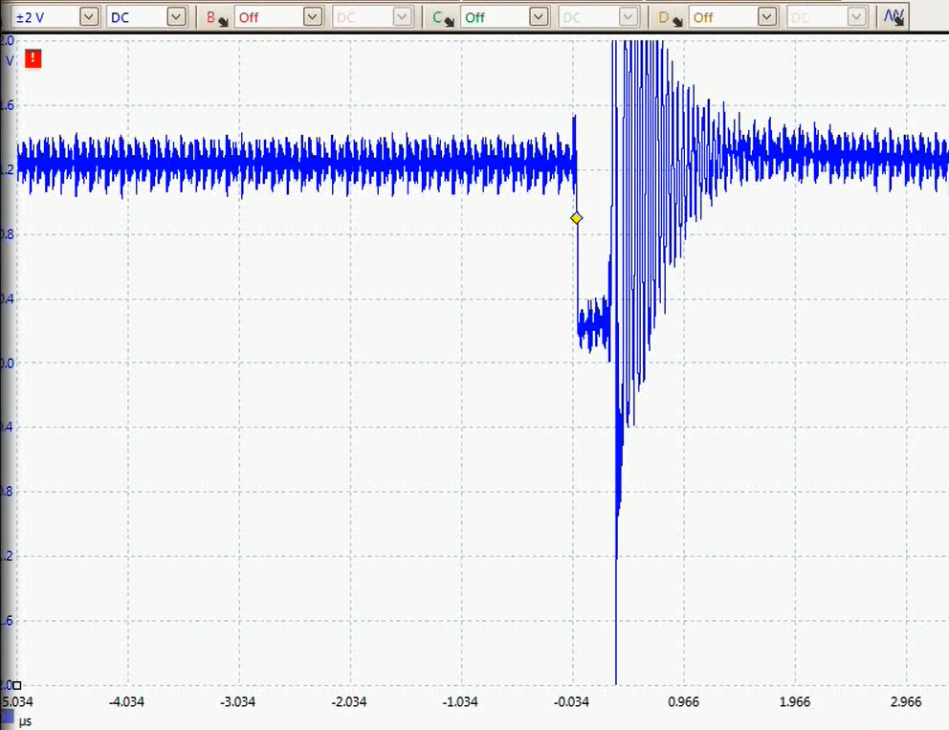
Part 2 – Fault Injection
What happens if code doesn’t execute correctly?
What if we can cause incorrect branches or other such problems?

Slide 34
What can you do #1: LPC1114 CRP Levels
Good target for VCC glitch – only need to corrupt one bit to unlock device
This was presented at RECON Brussels by Chris Gerlinsky in 2017 (2 years ago).
Level | Flash Value | JTAG/SWD | Serial Bootloader
NO_ISP | 0x4E697370 | Enabled | Disabled
CRP1 | 0x12345678 | Disabled | Subset of commands (read disabled)
CRP2 | 0x87654321 | Disabled | Subset of commands (read disabled)
CRP3 | 0x43218765 | Disabled | Disabled. Claimed impossible to recover
Invalid | Any other value | Enabled | Enabled

Slide 35
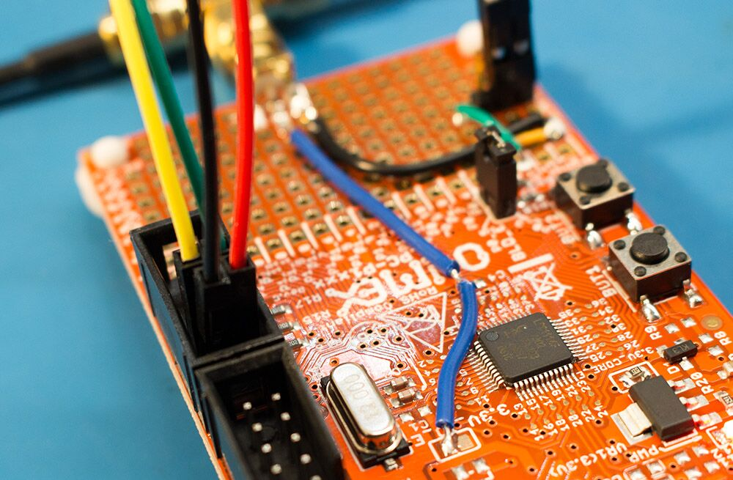
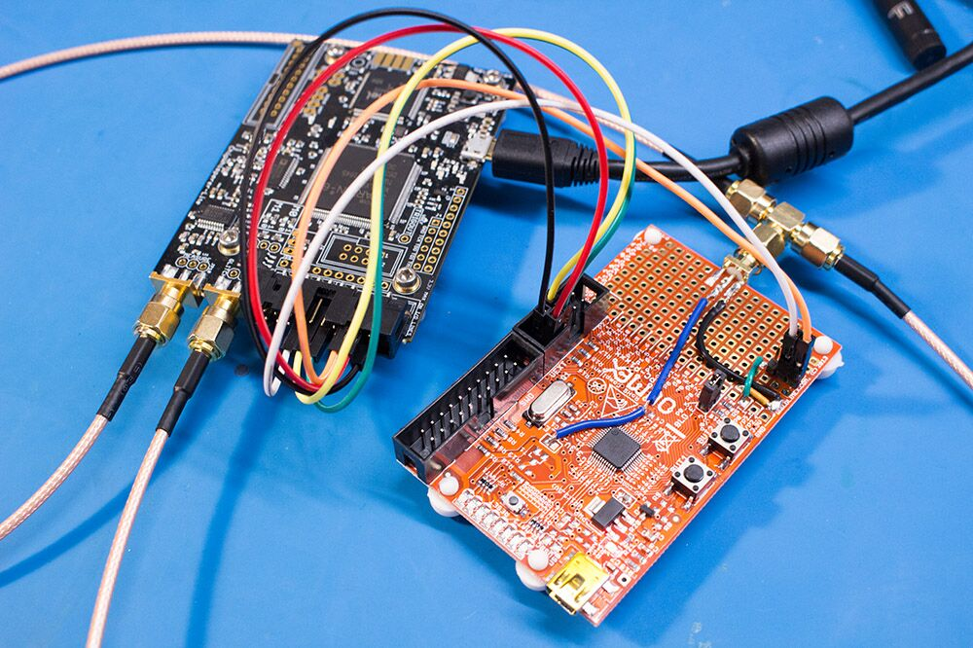
Hardware Setup

Slide 36
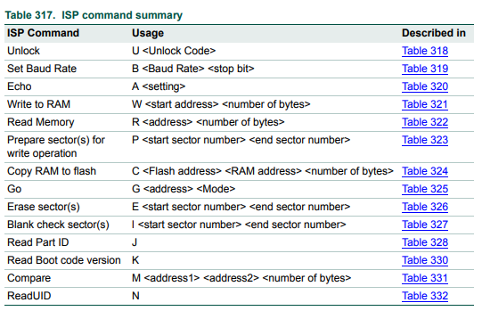
Bootloader Commands

Slide 37
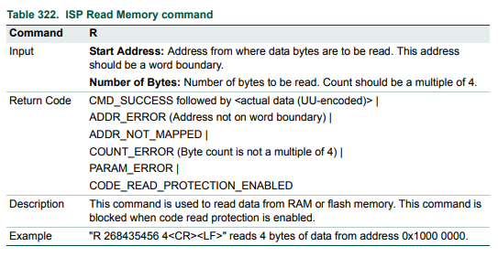
Read Memory Attempt

Slide 38
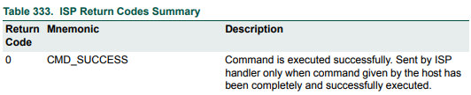
Expected Results
Read returns 19 if CRP is enabled, 0 if it isn’t

Slide 39
Enough Chat – Let’s see this work!
<Live Demo Hopefully>

Slide 40
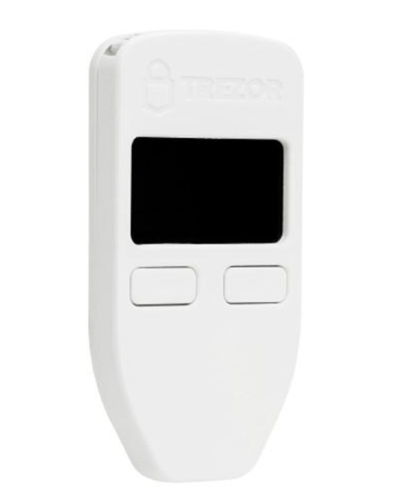
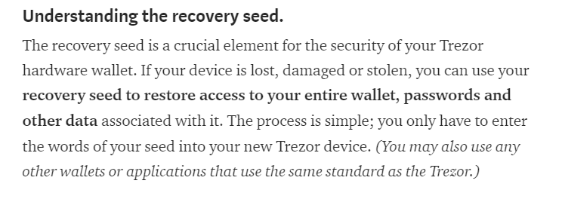
What can you do #2?
Bitcoin wallet → stores some data that should be hard to get out.
Most important part: ‘recovery seed’
From Trezor documentation:

Slide 41
Trezor Bitcoin Wallet
NOTE: This problem I’m disclosing has been fixed with issued firmware patch.

Slide 42
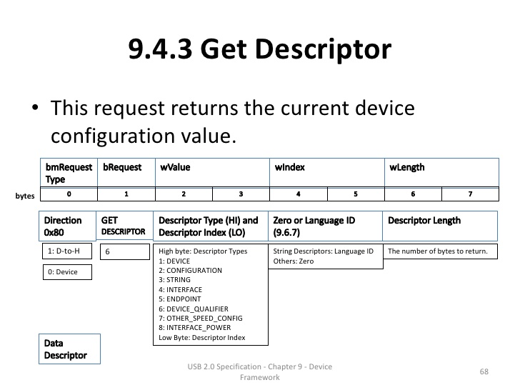
wLength → Host Provided Max Request Size

Slide 43
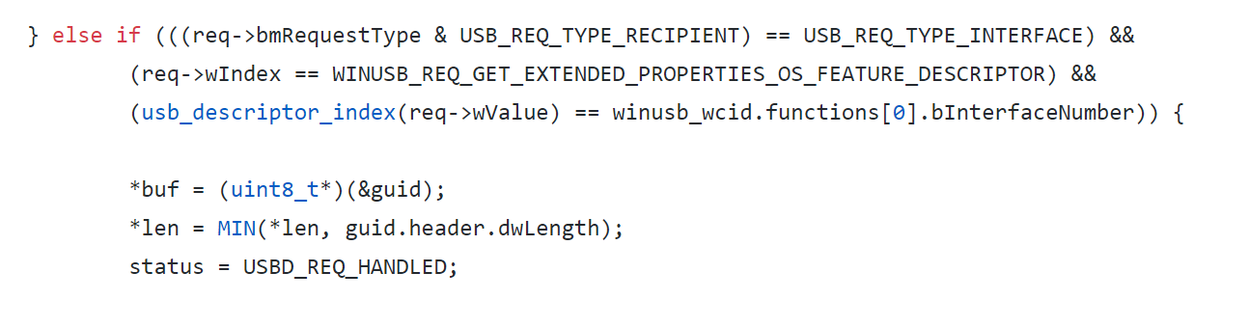
Example: USB Stack in Trezor

Slide 44
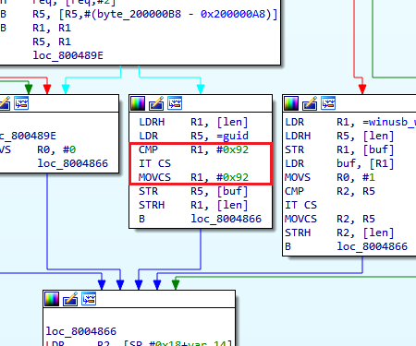
Example: USB Stack in Trezor

Slide 45
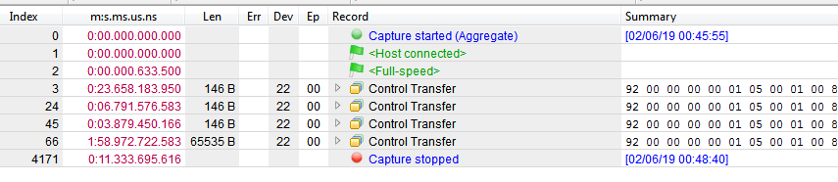
Validate Possibility: Emulate Fault with Debugger
Expected response (146 bytes)
Use debugger to skip MIN() check.

Slide 46
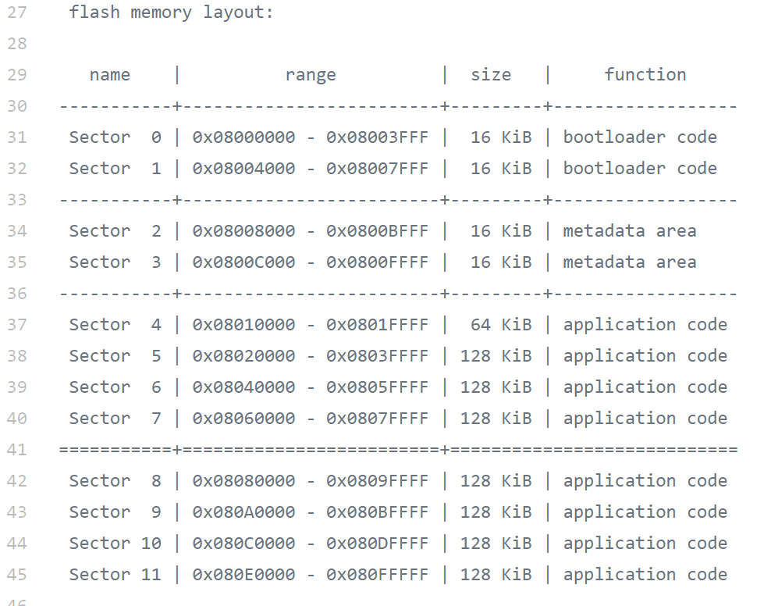
Descriptors when in bootloader mode saved here!
Recovery seed, device PIN saved here!

Slide 47
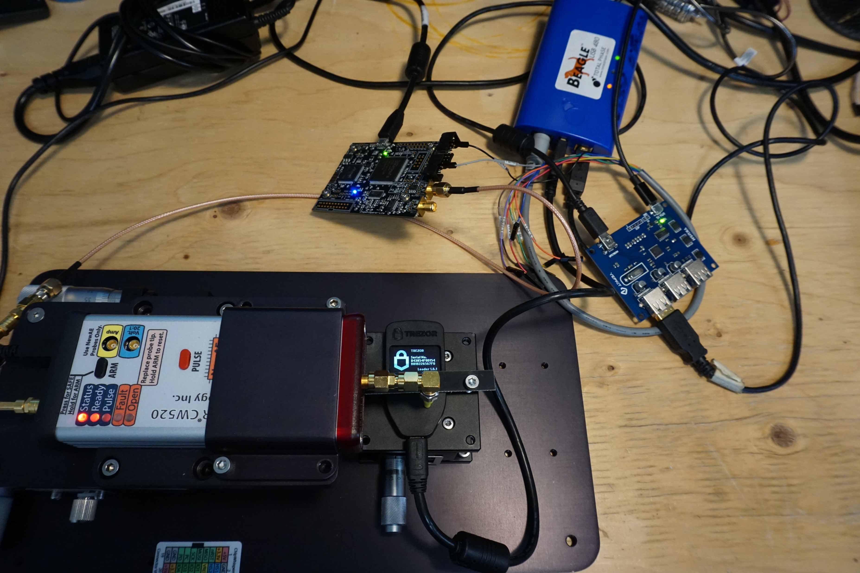
Beagle480 (trigger on USB packet)
ChipWhisperer
Target
USB Switch (hard reset required due to hard fault vectors)

Slide 48
How to protect against this?
Lots of anti-glitching countermeasures in software possible, can’t cover them all here.
Remember multiple glitches possible – but requiring them does increase complexity considerably.
Examples for Trezor wallet I suggested:
  Limit function capabilities – if your usb control endpoint only ever sends 256 bytes, mask higher bits at multiple locations!
  Store sensitive data with MPU “traps” around it – if someone glitches a buffer they will read the invalid area first.

Slide 49
What Can You Do?
This presentation is not designed to make you give up all hope.
Crypto can be broken. Faults can be inserted. These realities have been known for some time (DPA is 20 years old now).
As engineers you are responsible to understand realistic threat models. Every IoT device doesn’t need DPA/fault countermeasures. But you should be prepared – be it software changes, hardware changes, legal disclaimers, etc.

Slide 50
How To Learn?
  ChipWhisperer is a fully open source project (software, hardware, firmware, documentation).
  Workshop running here at Embedded World to show you a quick intro to Side Channel Power Analysis (not F-I sorry).
  Look out for online “cloud-connected” hardware that will let you experiment with this from anywhere!

Slide 51
Questions?
Colin O’Flynn
colin@oflynn.com
@colinoflynn
Or come visit at 4A-313!
Check out the paper for more details too!
These slides to be posted on oflynn.com

